Slide 1
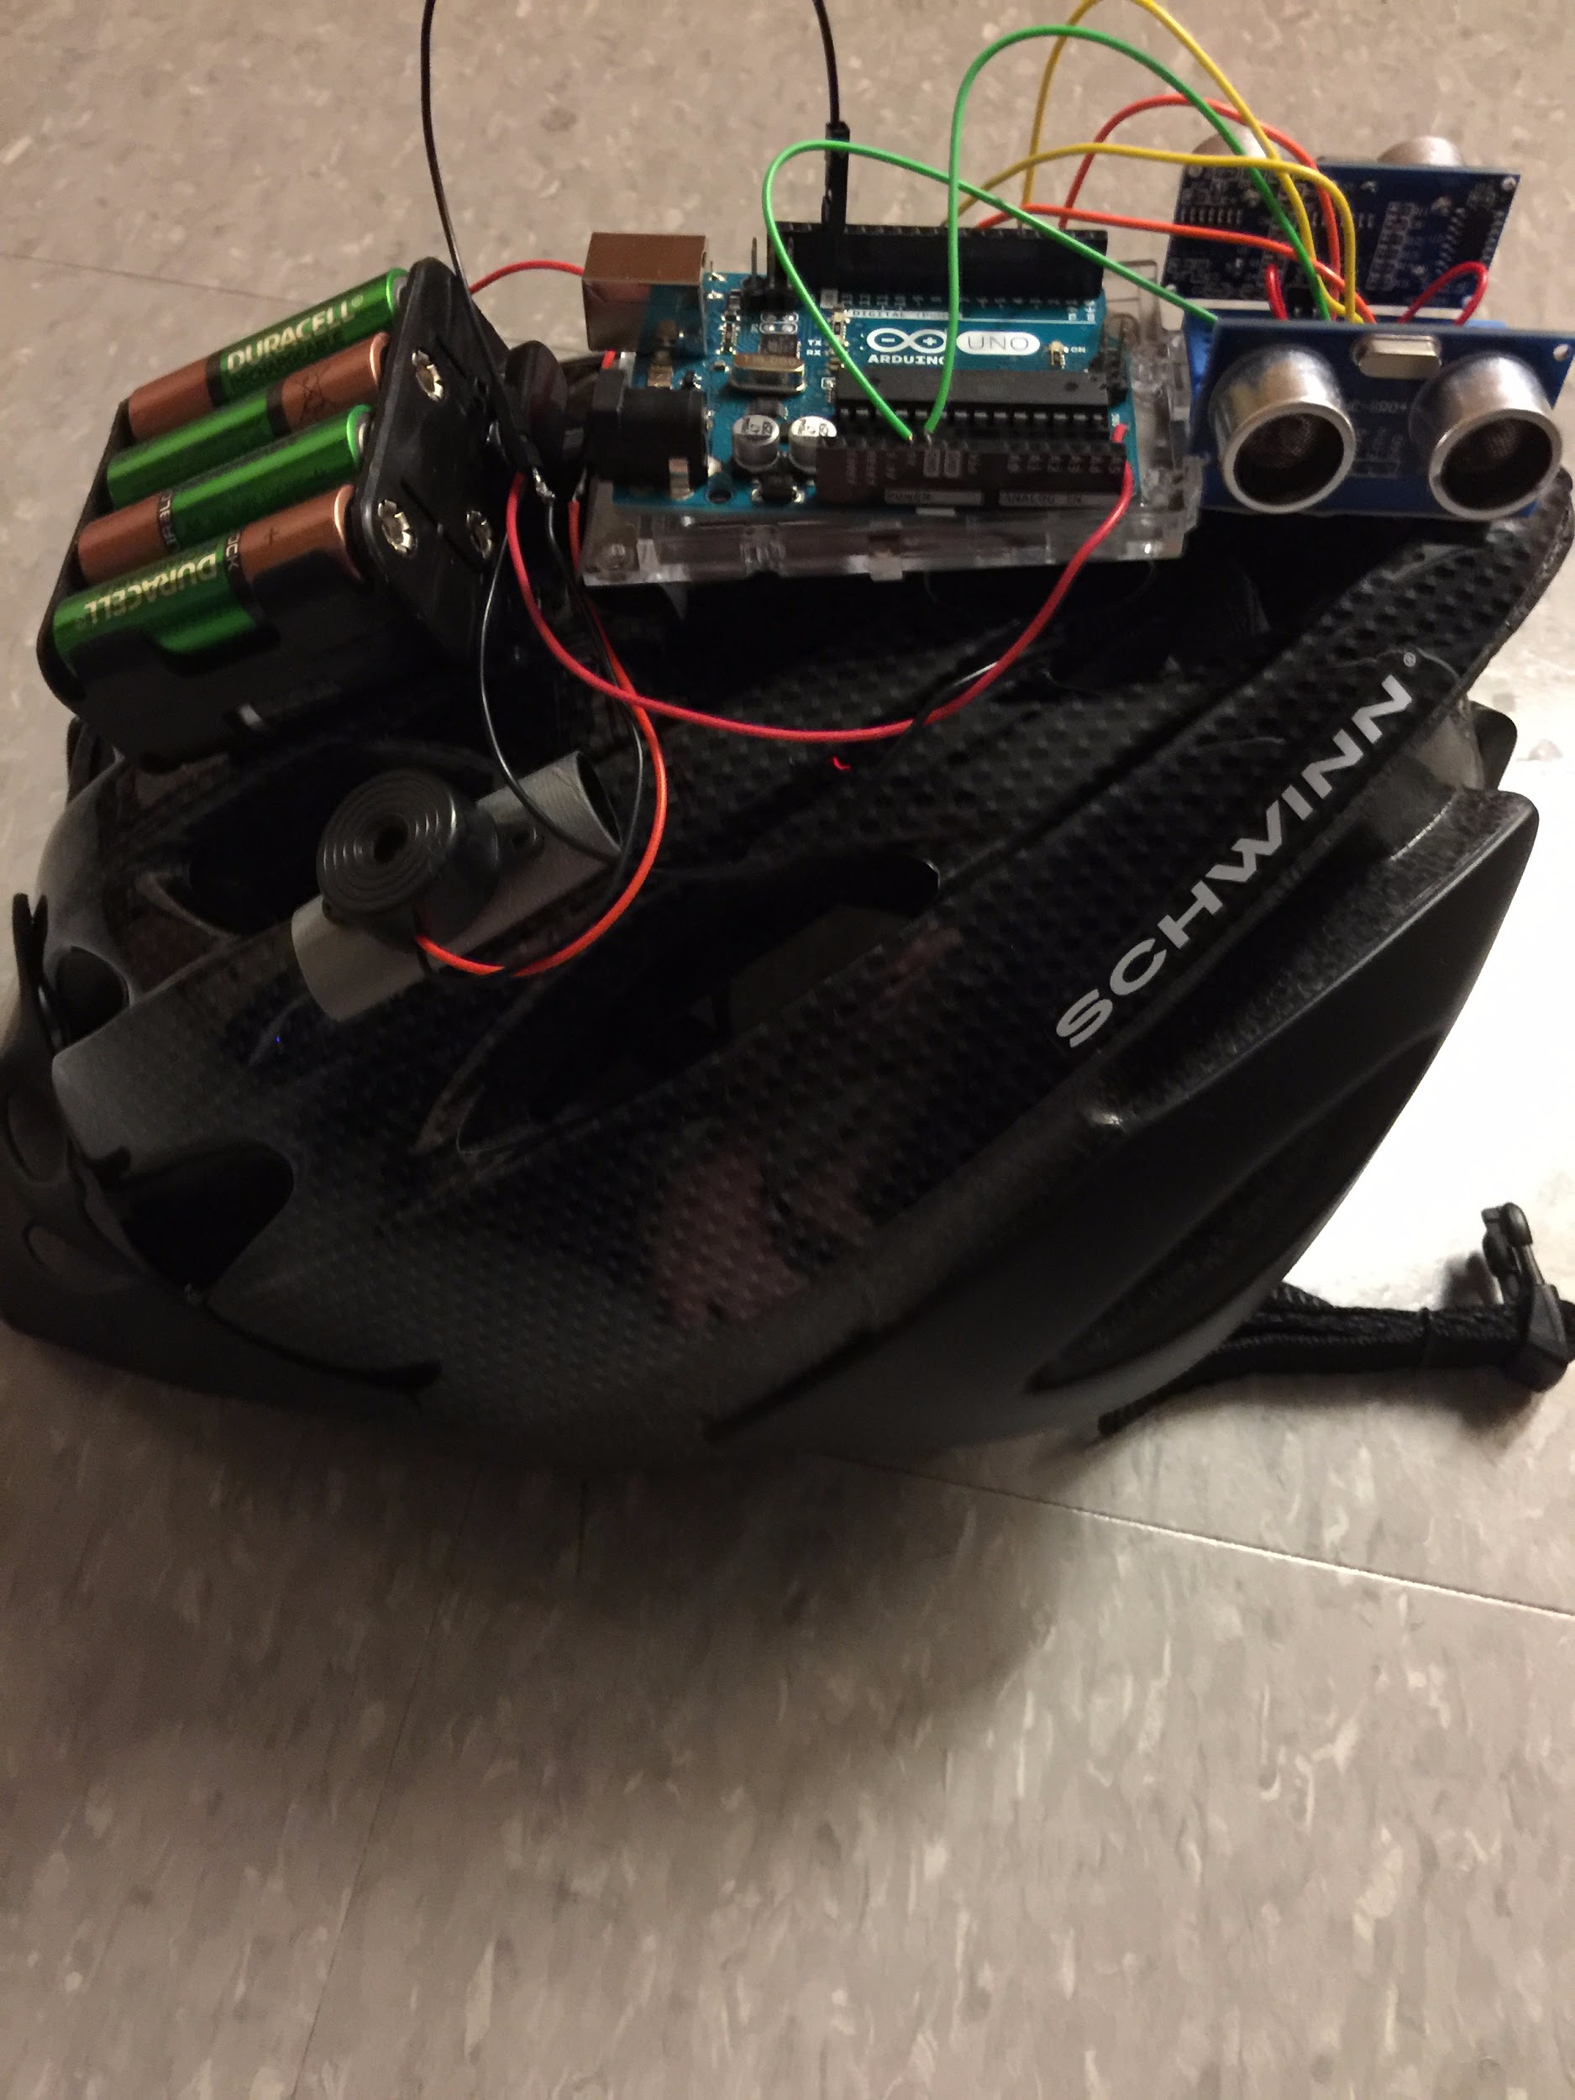
Elevate
A custom built safety helmet for recreational riders with a supported mobile application that supplements the riding experiencing.
Matthew Horger, Jake Rauchen, Kevin Tayah
Group # - 46

Slide 2
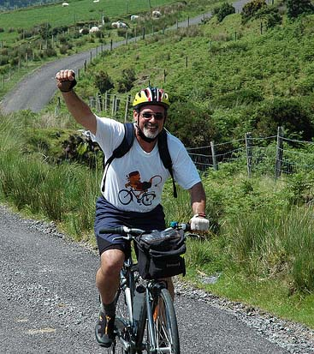
Motivation for Prototype
Safety of riders
Enjoyability for riders
Professional Uses
Competitions, Races, etc.

Slide 3
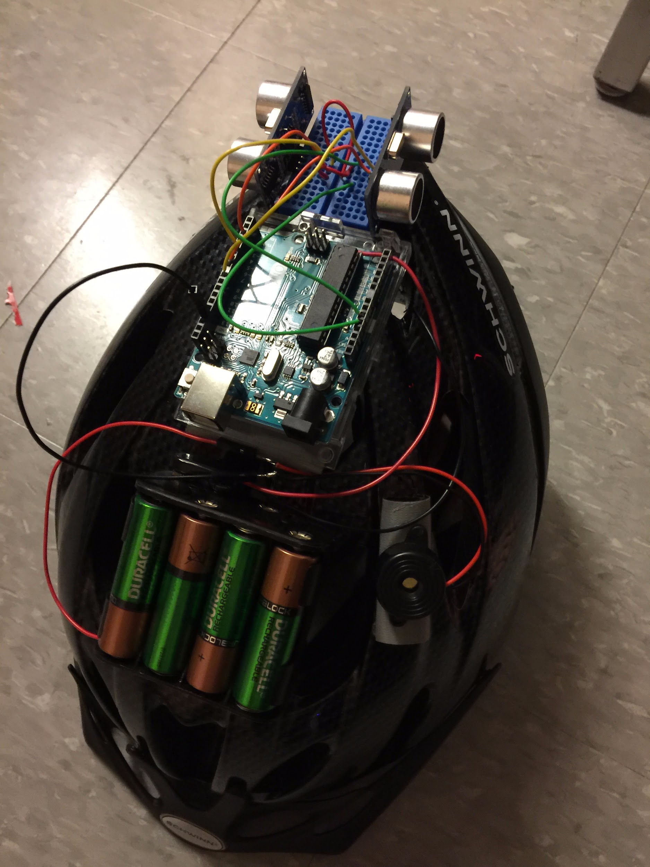
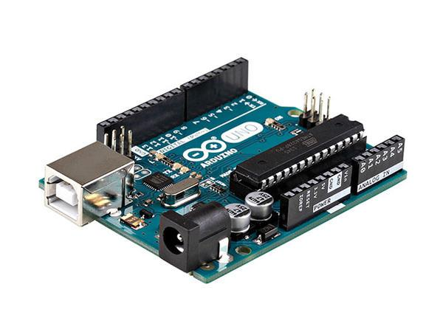
Helmet Demonstration

Slide 4
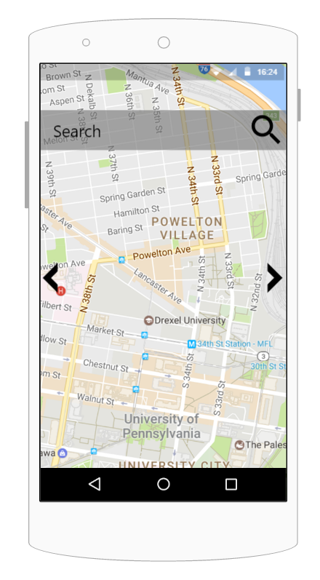

Application Demonstration

Slide 5
Requirements Fulfilled
Arduino Helmet
Rechargeable battery module to power helmet
Users have to purchase wall charger / use disposable, non rechargeable batteries
Mobile application prototype - Android
Provider for Python server / mySQL Database for GPS Data

Slide 6

Further Requirements in Development
Operational Database using Plone CMS
GPS Connection with Helmet
Collision Sensor Implementation
Working Search Bar in Application
Data Connection between Plone and Helmet/Application
Easily Accessible JSON Data Output for Sensor Readings

Slide 7

User Feedback
Integrity of the modules within the helmet
Charging batteries is a pain and takes too long
Greater baselines for modules
Sensors tested to have range of 5 meters
Mobile Application for Apple

Slide 8

Lessons Learned
Data connections are harder to establish and are expensive
GPRS - $10 / month
Wifi - $40 / month
Mobile application building takes awhile
Hardware sometimes isn’t compatible with software
Arduino can’t connect to iPhone to be pair via bluetooth
Teamwork is vital to success

Slide 9

Future Improvements and Conclusion
Finish requirements for improved prototype
Potentially partner with a business for research
Indego, IBX, etc
A great deliverable for the timespan given
Prototype can go much farther with funding / time

Slide 10
